Slide 1

GREEN HORIZON
Turning Depleting Infrastructure into Clean Energy Opportunities

Slide 2

PROBLEM STATEMENT
Design and develop a solution, such as Power Apps, Azure Web App or any other application that provides guidance to asset owners if depleting oil and gas assets can be repurposed into hydrogen generation / transmission or carbon capture facilities using allocated decommissioning funds

Slide 3
PROBLEMS IDENTIFIED
Resource Depletion
Assessment of Asset Condition
Technology Selection and Integration
Sustainability and long-term planning
Data management and analytics

Slide 4
WHAT DO WE INFER PROBLEM STATEMENT?
We need to specify the age, quality, and specifications of the given equipment for the repurpose of hydrogen and carbon sequestration.
According to the allocation of decommission funds, hydrogen generation revenue and carbon sequestration revenues are separately calculated according to maximum profit with respect to hydrogen and carbon.
If both methodologies lead to loss, then we prefer to accomplish the decommissioning of the equipment.
For a wide range of areas, we need the monetization of money to calculate the cost incurred and revenue generated for the project according to the user's or client's requirements.

Slide 5
OBJECTIVES
Optimize Resource Allocation: Guide asset owners on how to optimize the allocation of decommissioning costs and other related resources towards the prospective value of the transformed assets.
Ensure Compliance and Sustainability: Ensure that organizational compliance to these laws and policies is monitored whilst at the same time encouraging sustainable practices.
Support Decision-Making: Provide relevant quantitative and qualitative information to ensure that the decision-makers have all the information they need to make the right decisions during the various phases of the project.
Mitigate Risks: As with the following considerations, it is important to identify and avoid risks that may hinder the successful completion and sustained viability of the project.

Slide 6
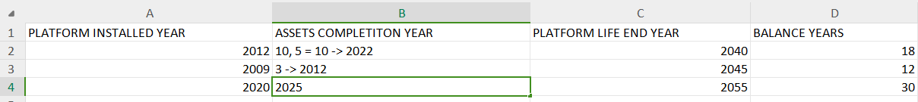
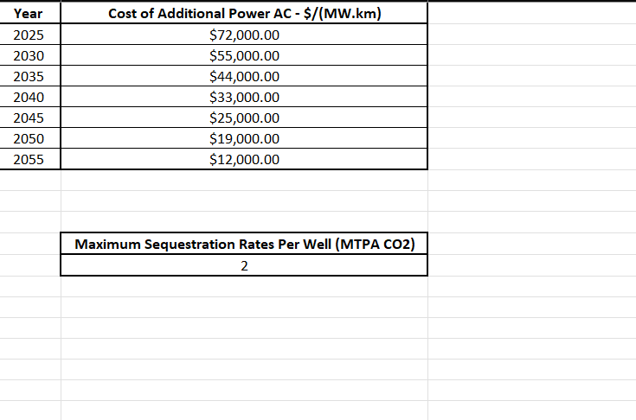
CARBON CAPTURE
As the maximum sequestration can be done (MTPA) is 2, there are 2 wells, so the number of (MTPA) is 4 now - inorder to capture them the Additional power is used.

Slide 7
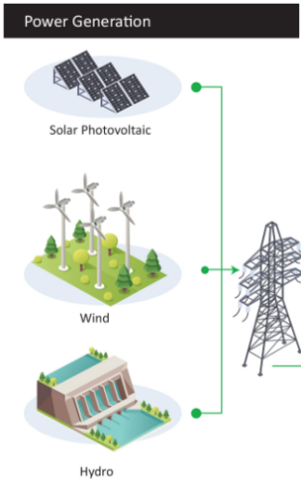
HYDROGEN GENERATION
We are extracting the power source from the windmills, solar, etc. We won’t be emitting the CO2, on the other side, additional AC power is not required for the hydrogen production.

Slide 8
NOVELTY
Comprehensive Profit Calculation Framework: We have developed a framework that includes theoretical procedures involving mathematical calculations to estimate total profit, and experimental procedures that use predictive analysis models based on existing data to forecast potential outcomes.
Predictive Modeling for Profit Forecasting: We utilize a predictive model that integrates all relevant data sets to forecast potential profit or loss. This model generates visualizations of profit and loss through graphs using machine learning techniques.
Error Analysis and Accuracy Enhancement: Acknowledging the potential for errors in predictive modeling, we have conducted a thorough error analysis to identify possible types of errors. We then generate accurate error weights and create a corresponding accuracy score to refine and enhance the model’s predictions.

Slide 9
THEORITICAL EXPLANATION OF PROFIT ESTIMATION (CARBON)
COMPONENT: PIPELINE
COST OF INSTALLATION: $ 8,25,000/km
COST OF DECOMMISSION: $ 4,72,500/km
DIMENSIONS: 400km
CAPACITY(C) = Total Decommission Cost/Cost for Capture
Total Decommission = Length * Cost Decommission
Total Cost Transportation (TCT)= Length * Cost Transportation
Total Cost Storage (TCS) = Capacity * Cost Storage
Effective Selling Price(ESP) = Given Dataset
PROFIT = (TCT+TCS) - (ESP *C)

Slide 10
THEORITICAL EXPLANATION OF PROFIT ESTIMATION (HYDROGEN)
Total of Cost Installation (TCI) = Cost of Installation(CI) /Efficiency
C = TDC/CI
Total Production Cost (TPC) = PC * C
Total Transportation Cost = (Transportation Cost/100) * Length
Effective Selling Price(ESP) = Selling Price (SP)* Cost(C)
PROFIT = (ESP - Total Cost of Decommsioning(TDC))

Slide 11
NOVELTY
Error metrics Factor:
market trend
Inflation (Example: Market getting collapsed due to World War )
Technological Enhancement
Decommissioning Budget Allocation for Structural Health Monitoring: If repurposing options are not feasible and decommissioning is required, we allocate a portion of the decommissioning budget specifically for structural health monitoring.
Real-Time Monitoring and Anomaly Detection: Using the allocated budget, we implement live sensor data collection to monitor components such as pipelines. By analyzing real-time flow rate data and vibratory sensor data, we can detect anomalies and accurately locate any cracks or structural issues in the pipeline.

Slide 12
NOVELTY
Carbon Footprint Monitoring and Carbon Credit Management: We collect and monitor comprehensive data on carbon footprints to accurately determine the carbon credits earned. This data enables us to calculate the potential revenue from carbon credits. Additionally, the application supports trading or monetizing these credits using platforms like MetaMask.
Byproduct Treatment Recommendations: Employs machine learning techniques and available datasets to provide data-driven recommendations for processing and treating byproducts from algae cultivation. This approach maximizes resource recovery, enhances hydrogen production efficiency, and significantly reduces waste by effectively utilizing captured carbon.
Efficient Wastewater Utilization and Cost Optimization:
Wastewater Utilization: Utilizes a linear regression model to assess the toxicity of industrial wastewater and analyze samples to identify recoverable minerals. This analysis evaluates the suitability for algae cultivation, which not only reduces production costs by utilizing wastewater nutrients but also supports the efficient production of hydrogen from algae.

Slide 13

SUSTAINABLE DEVELOPMENT GOALS
We have adopted certain technologies based on SDGs are represented as:
Affordable and Clean Energy
Industry, Innovation and Infrastructure
Responsible Consumption and Production
Climate Action
Life below water
Life on land
These goals makes us our project to be sustainable in environment.

Slide 14
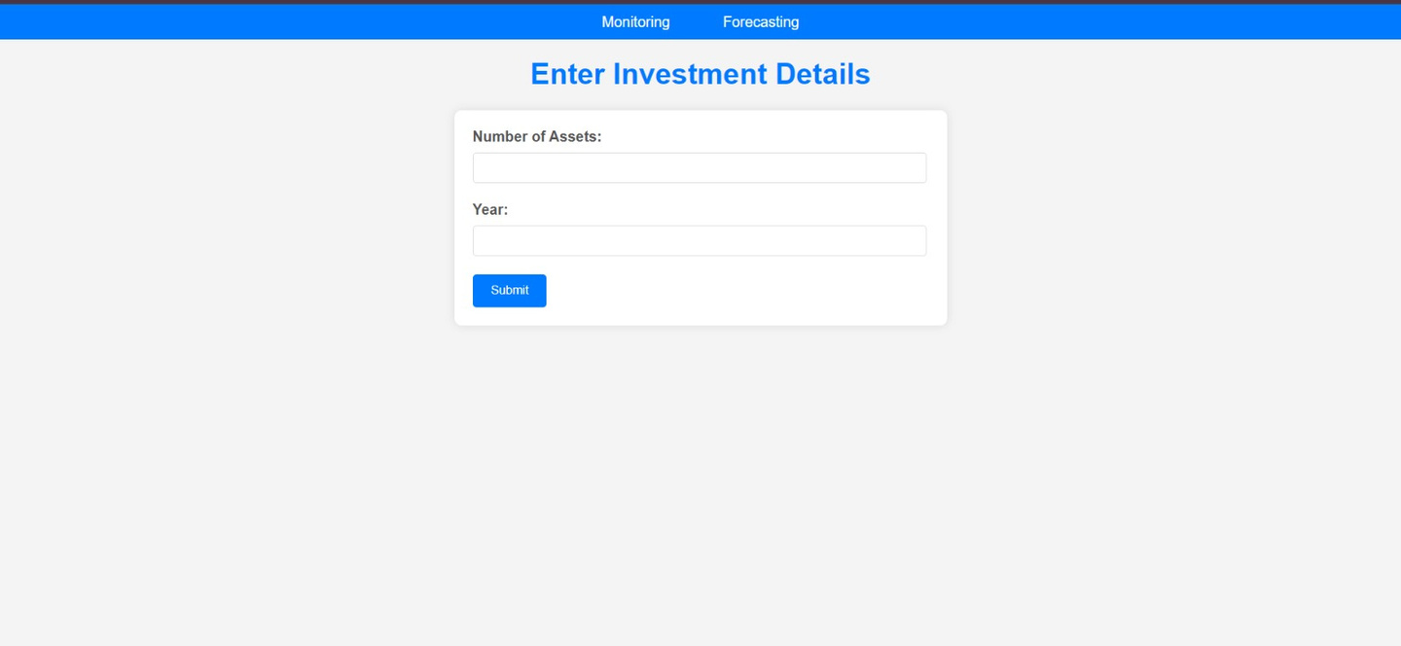

PROTOTYPE

Slide 15
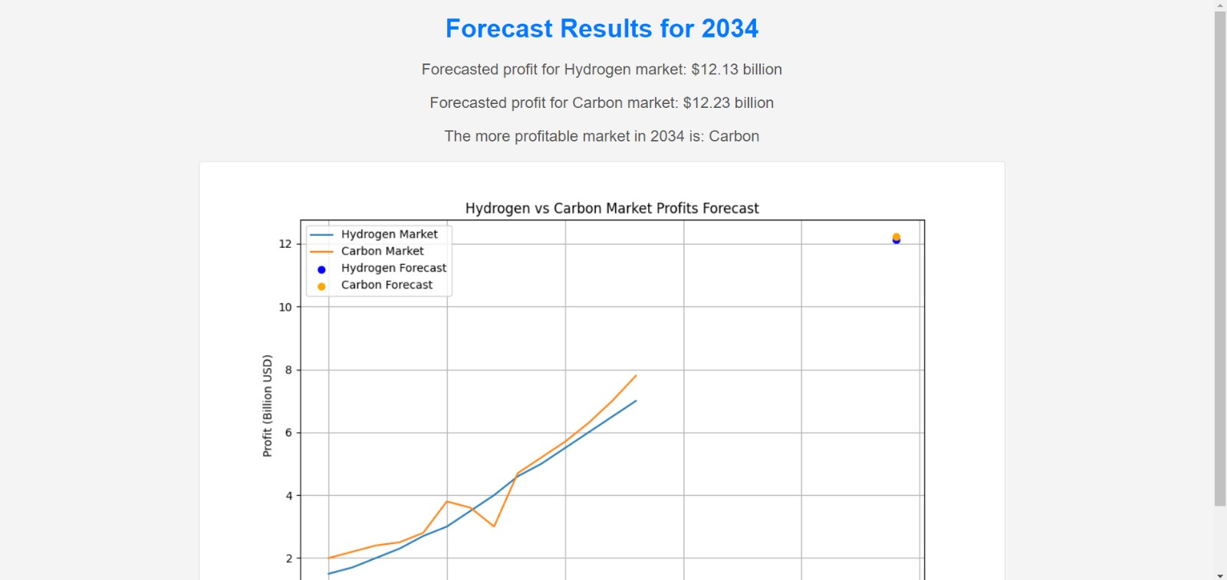
PROTOTYPE

Slide 16
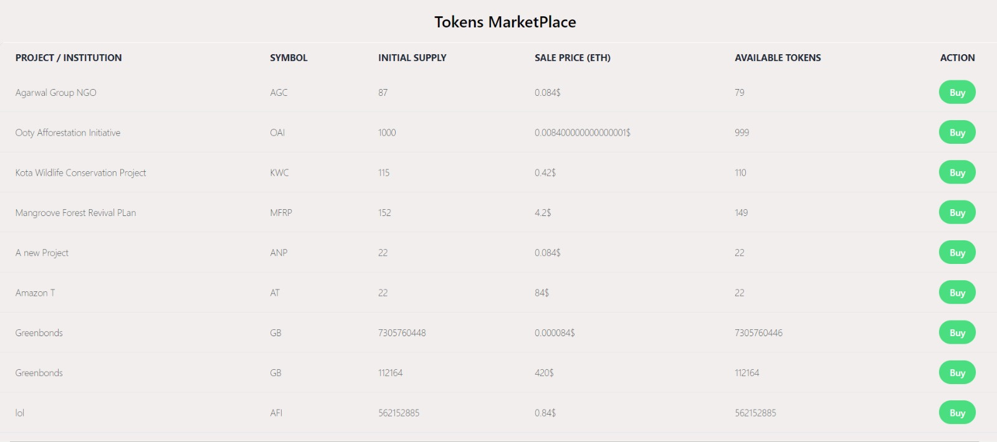
PROTOTYPE

Slide 17
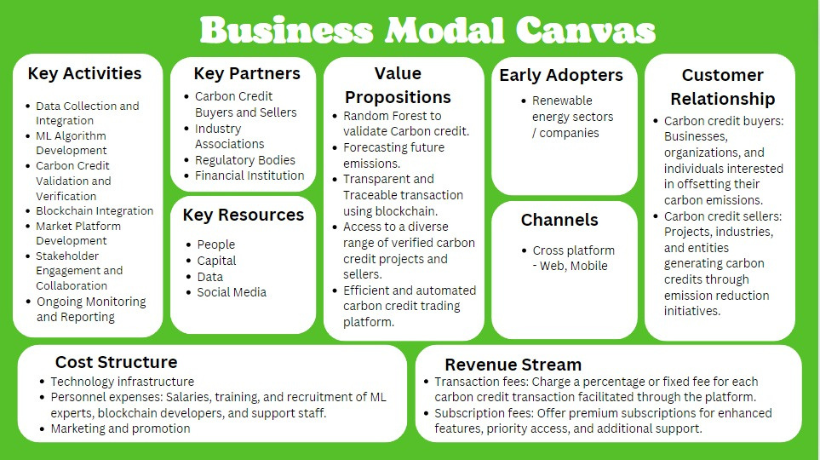

Slide 18

CONCLUSION
The project showed that depleting oil and gas infrastructure can be successfully converted into sustainable energy solutions, such as hydrogen generation and carbon capture based on profit efficiency. By providing comprehensive assessment tools and strategies, the project offered a practical approach for transforming legacy assets into valuable clean energy resources, highlighting a significant step towards a sustainable energy future.

Slide 19
Thank you!!!
From the Team Green Horizons...

Slide 20


TEAM MEMBERS
DHANUSH
DINESH
BRINDA PV
SANDHYA BARATHI K

